Slide 1
A Probabilistic Surface Registration Framework with Applications to Partial Data Analysis
PhD Defense
12.07.2021
Dennis Madsen

Slide 2
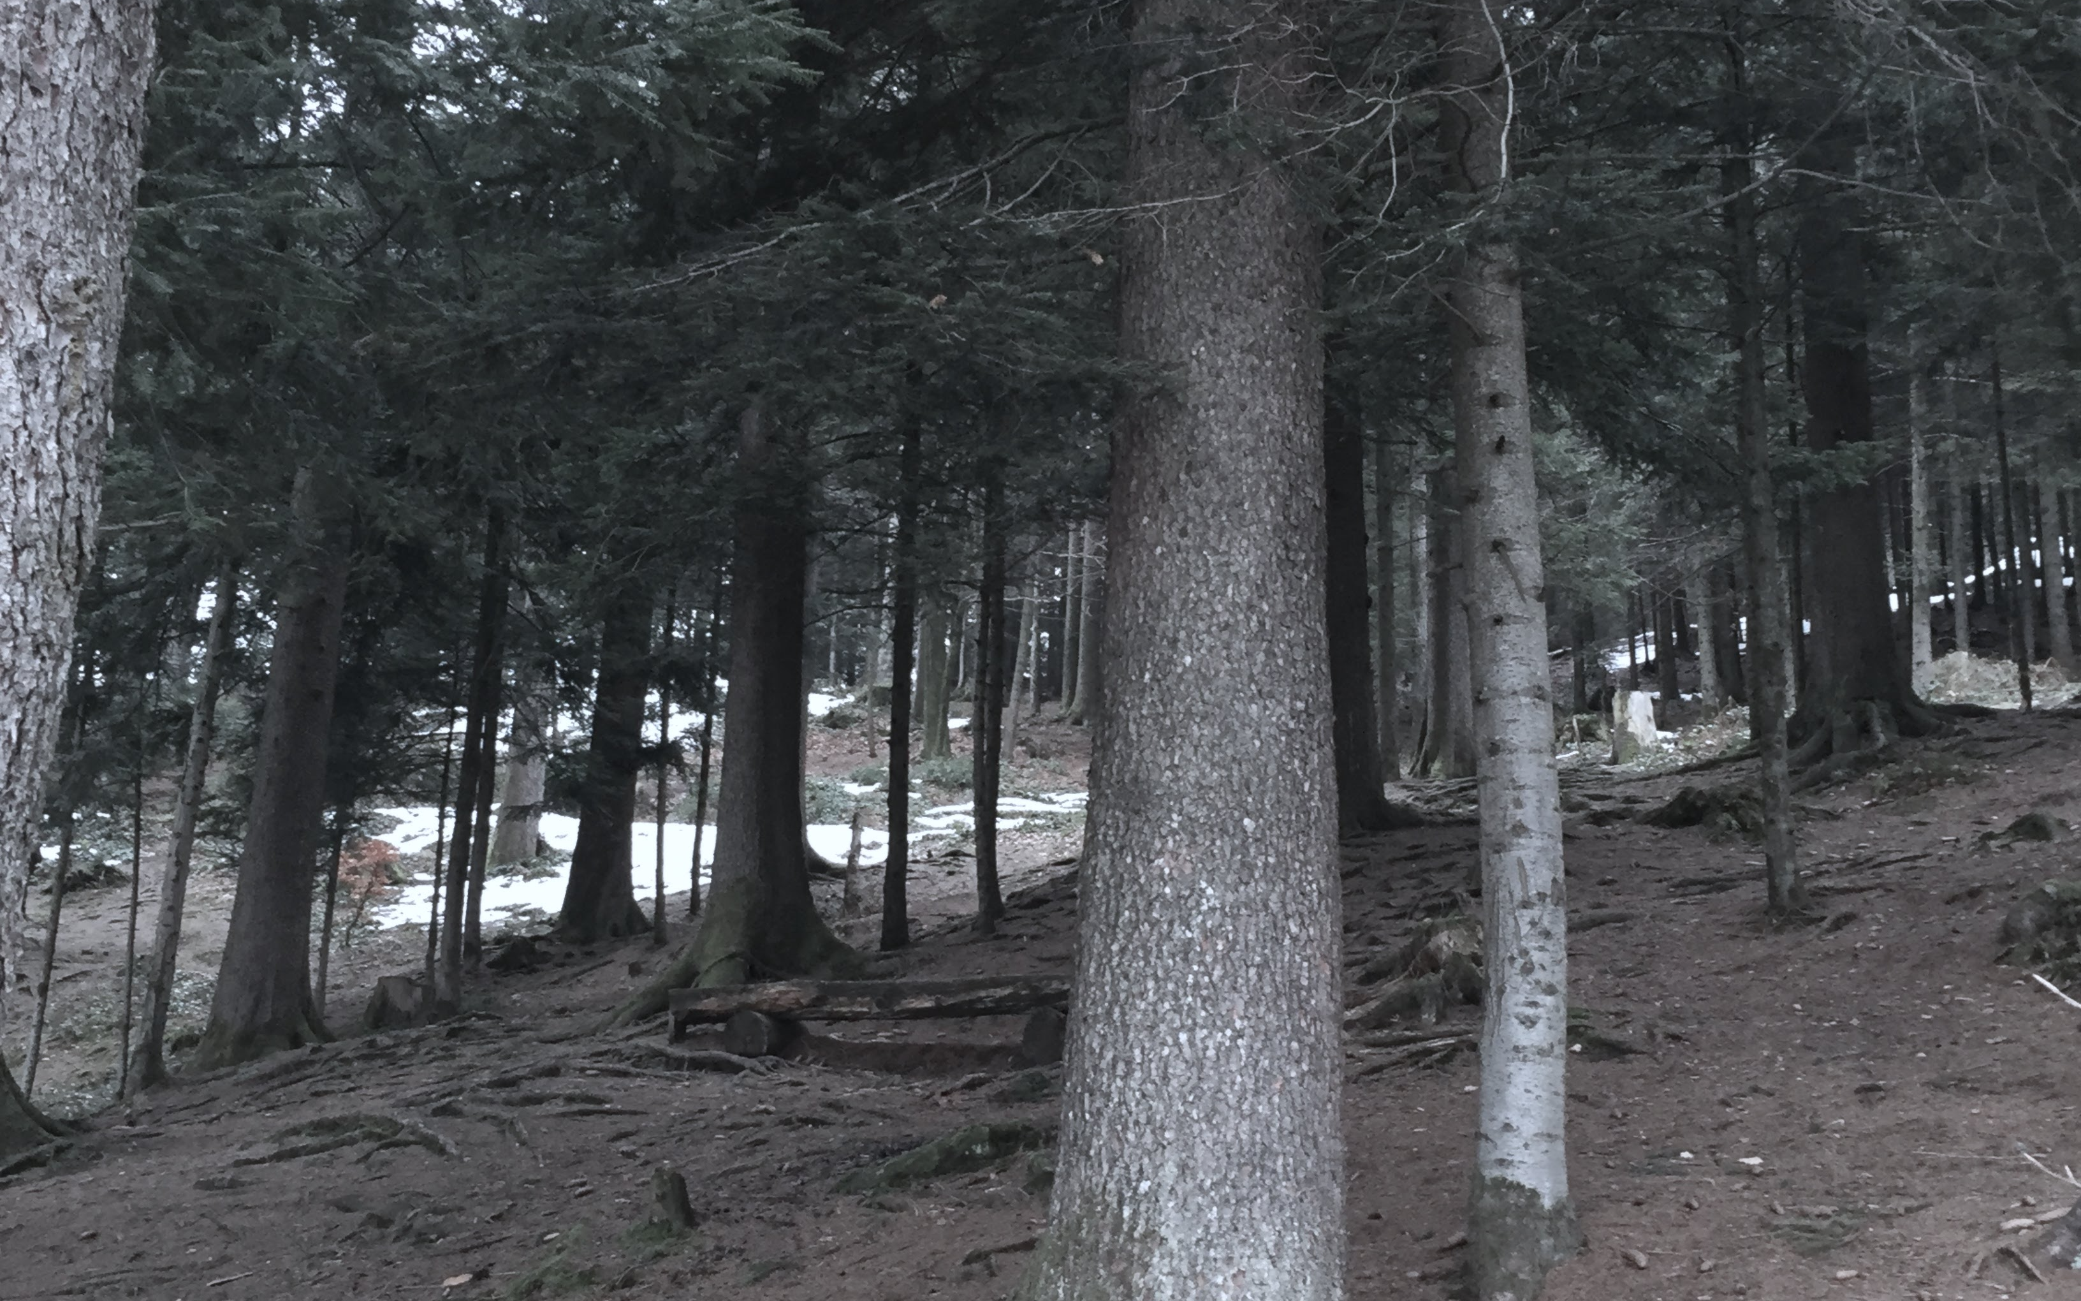
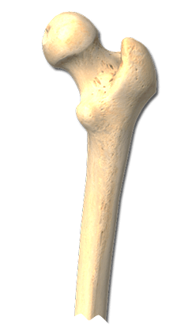



Slide 3
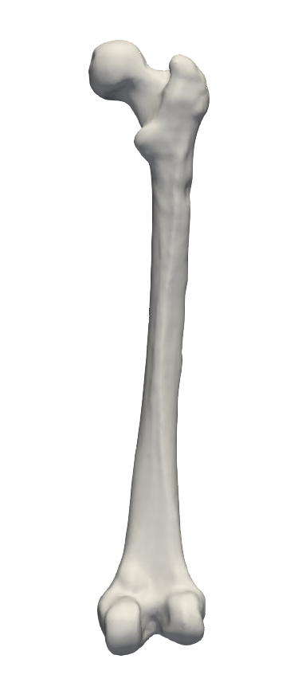
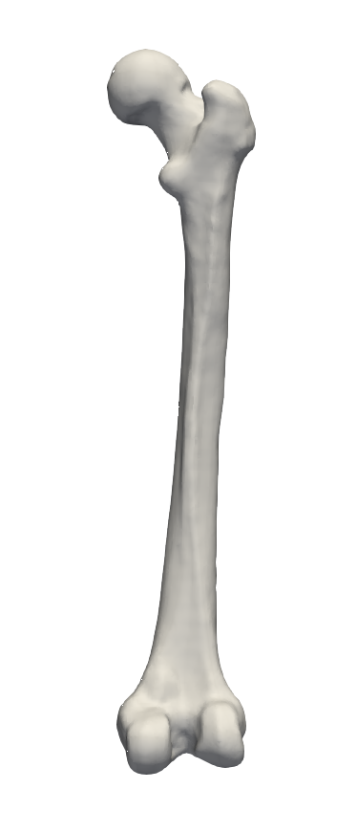
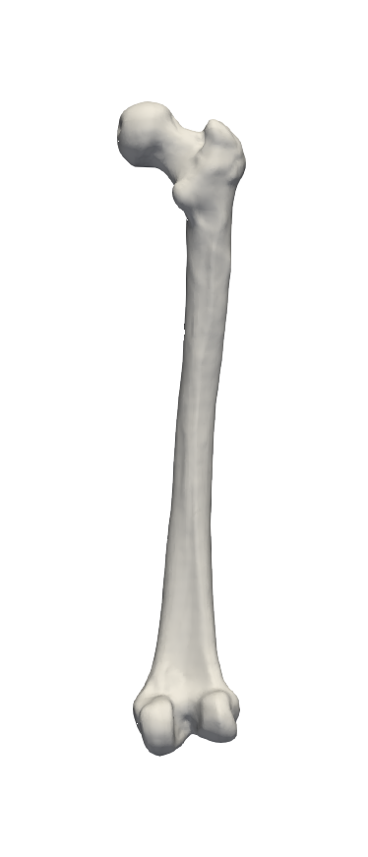
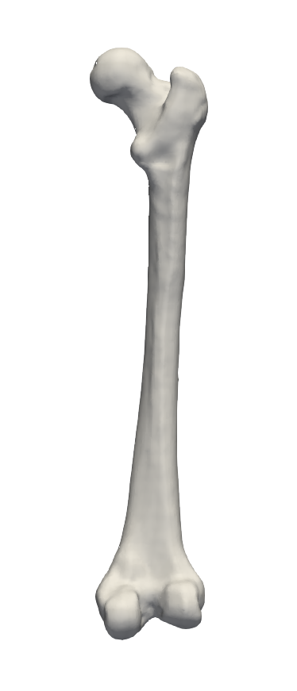
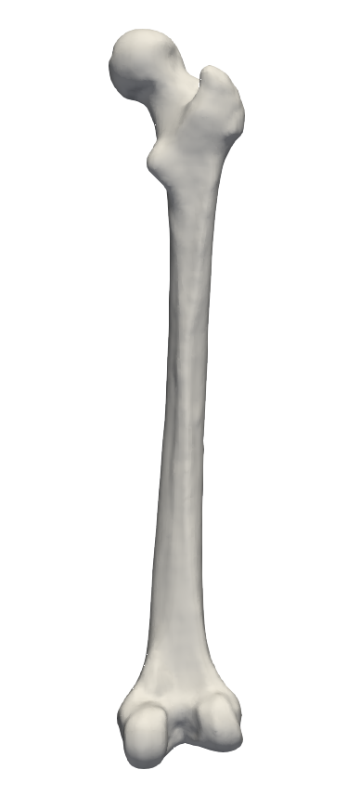
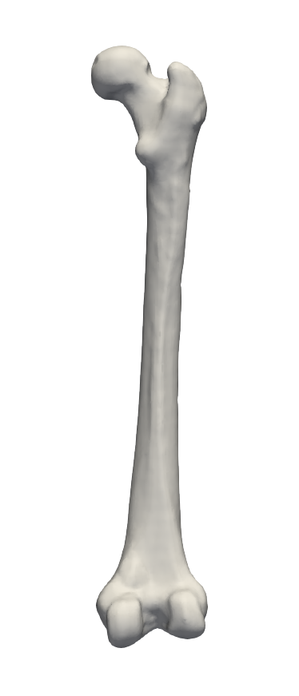
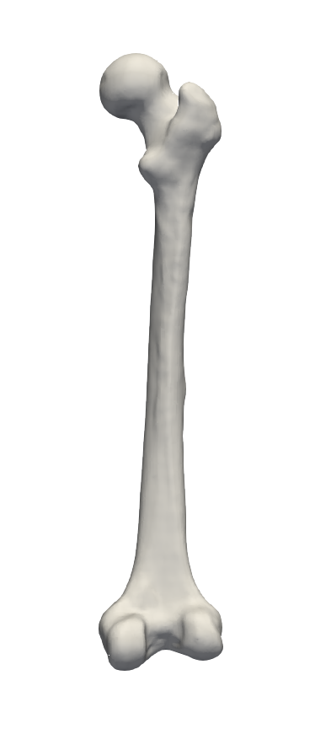
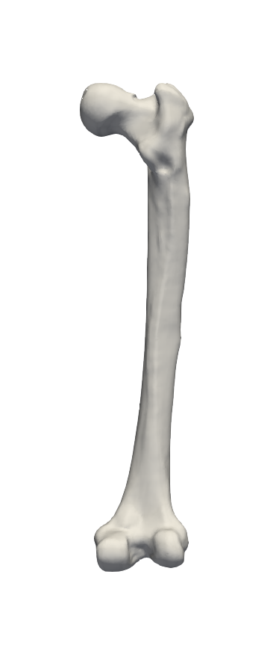
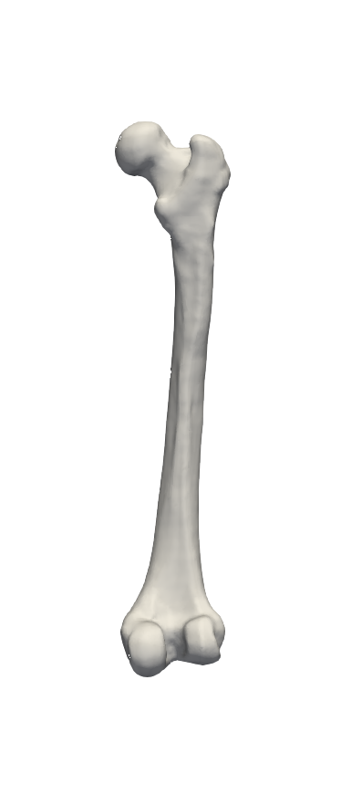
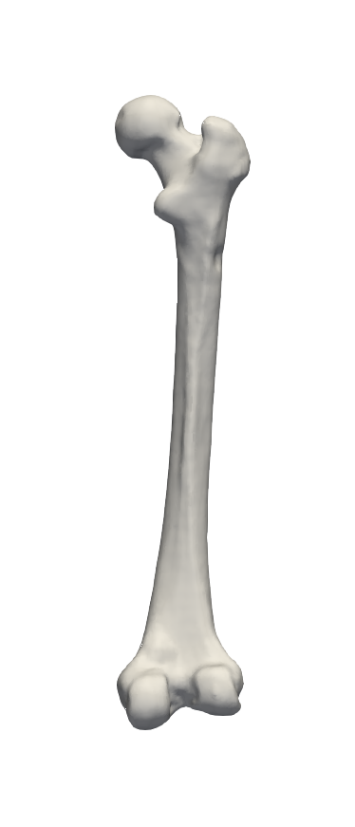
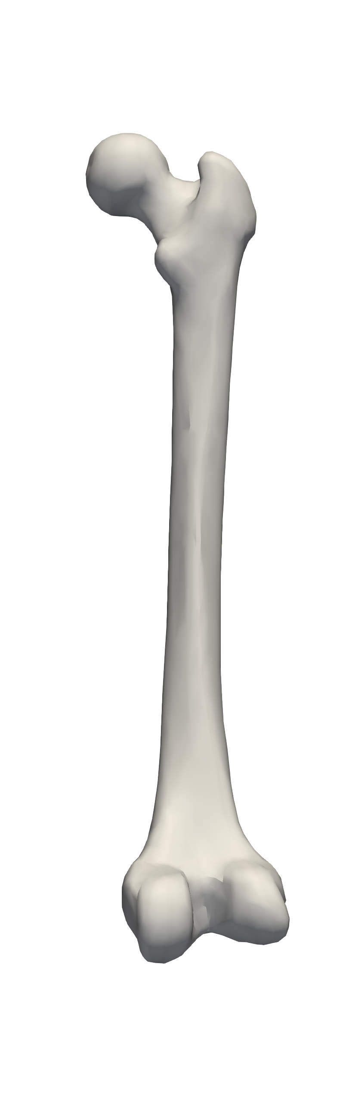
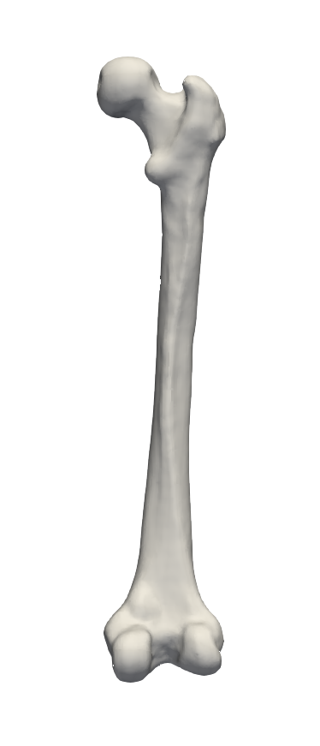
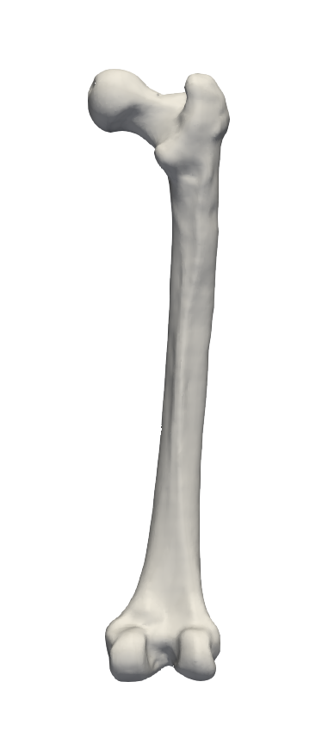

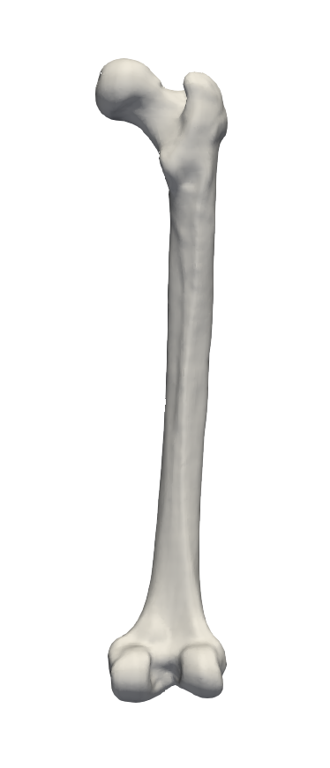
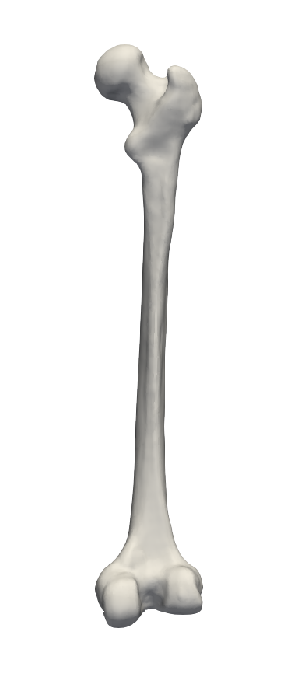
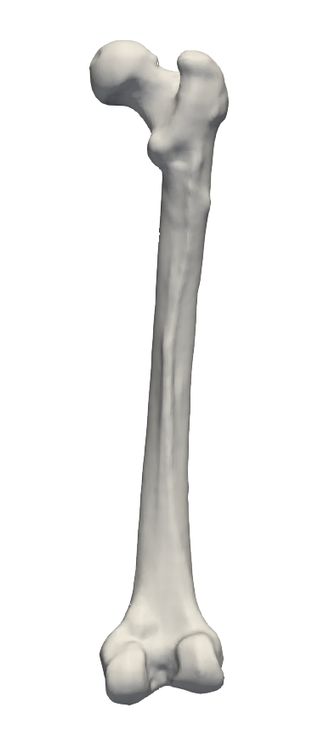
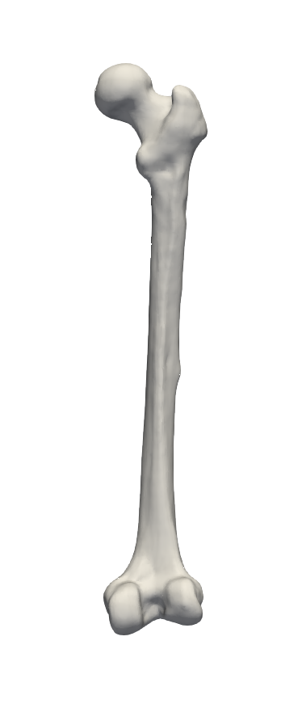

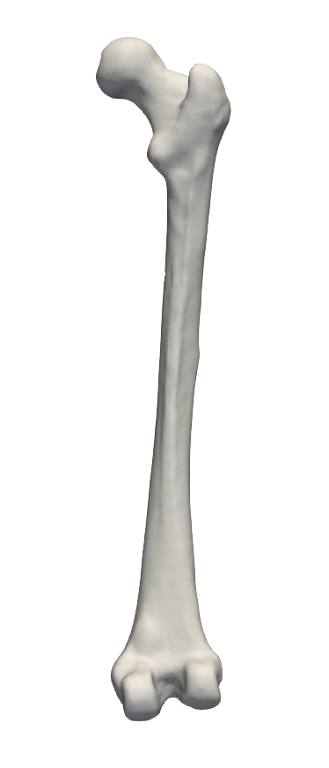
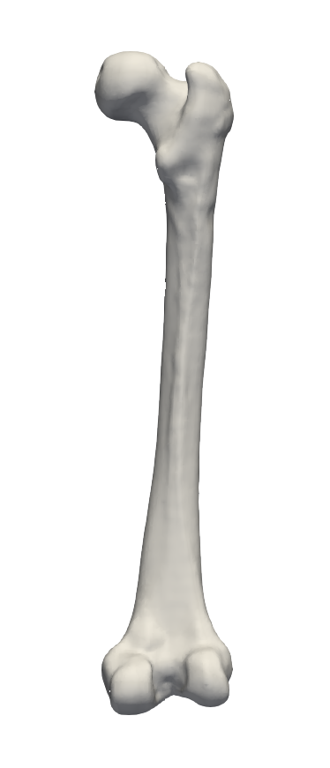

Slide 4
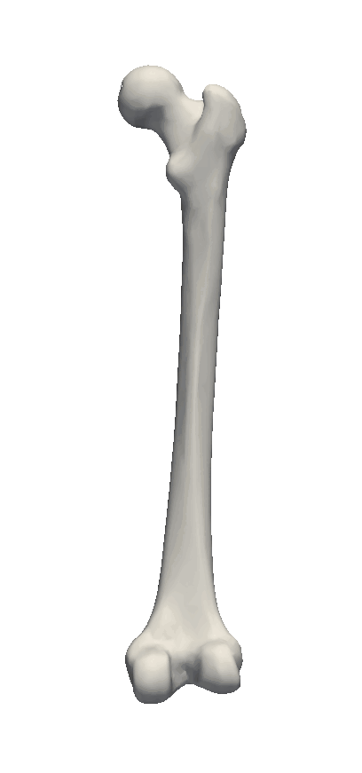
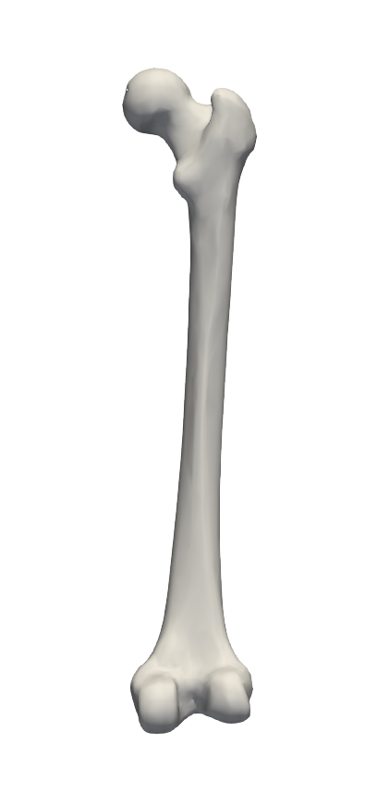
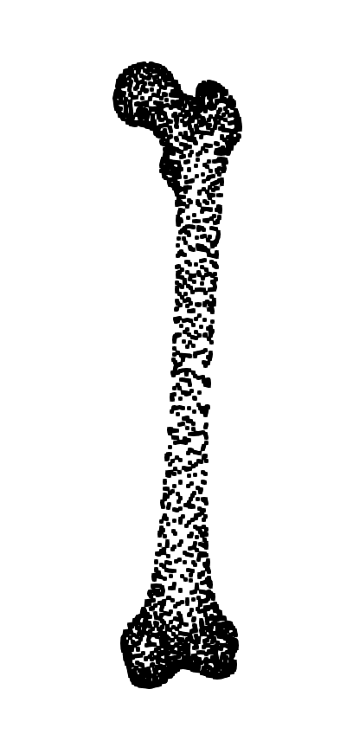
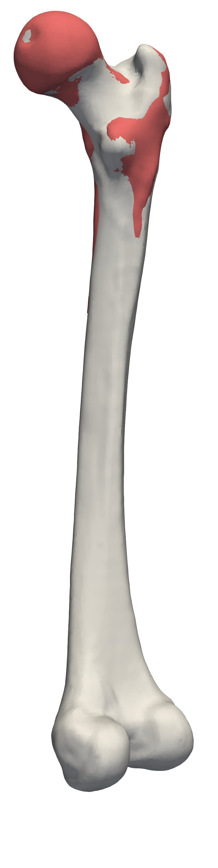
Point Distribution Model

Slide 5
Point Correspondence

Slide 6
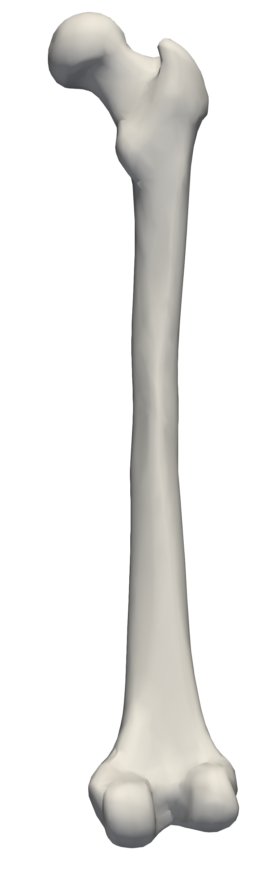
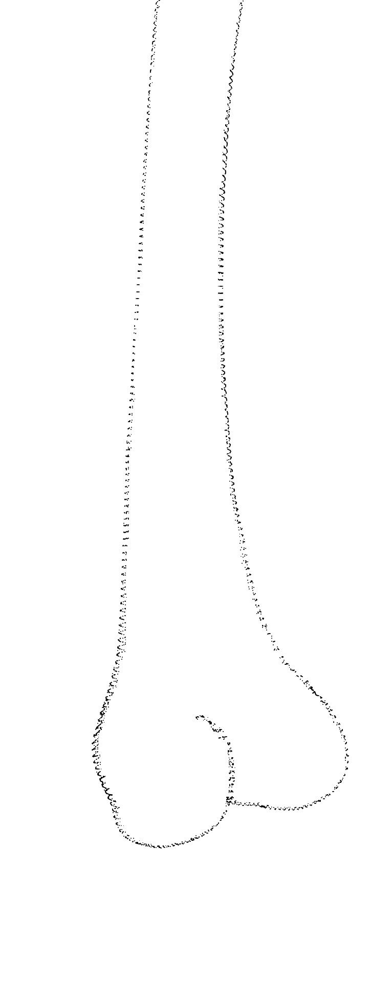
Point Correspondence
?

Slide 7
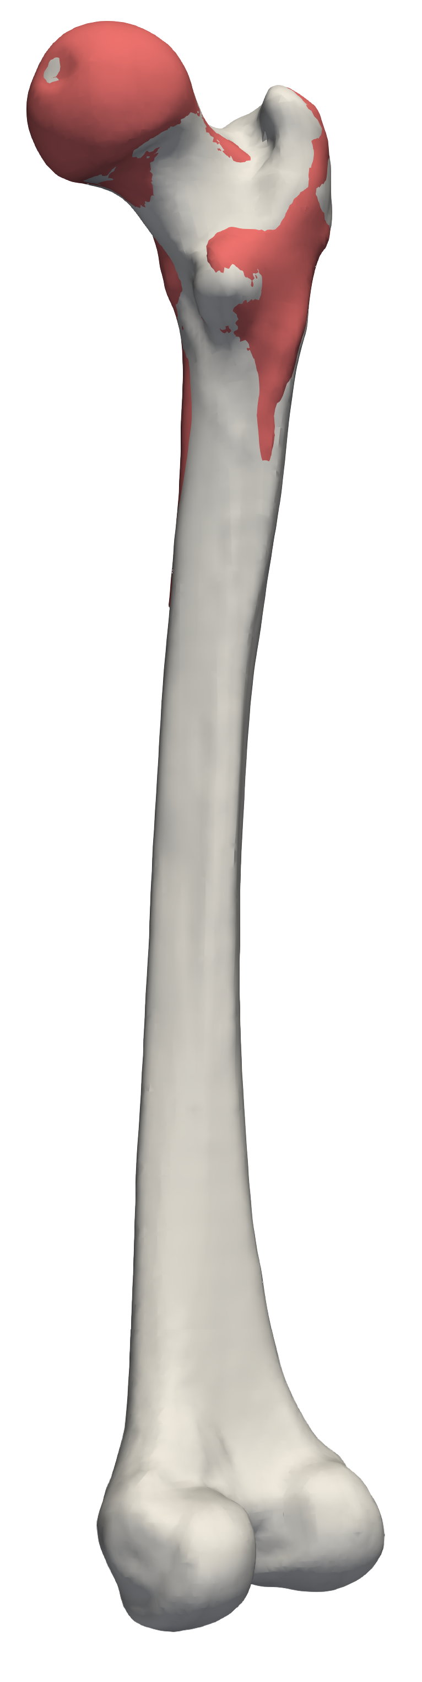
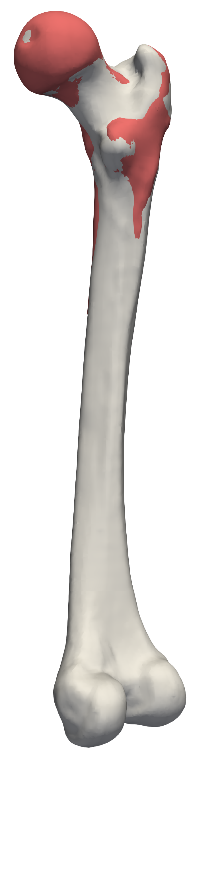
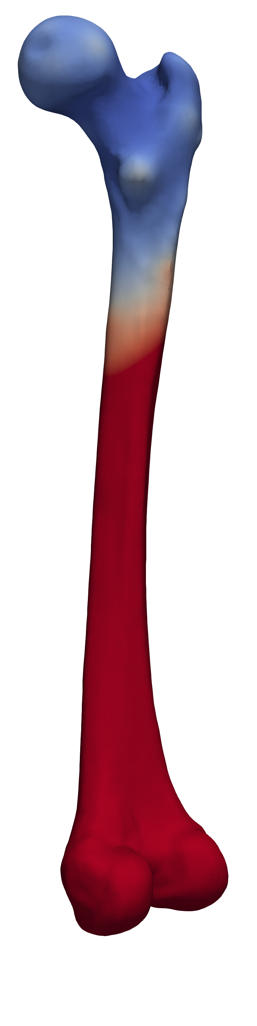
Point Correspondence
?

Slide 8
P-GiNGR
Contributions
A Closest Point Proposal for MCMC-Based Probabilistic Surface Registration
[Madsen et al, ECCV20]
GiNGR: Generalized Iterative Non-Rigid Point Cloud and Surface Registration Using Gaussian Process Regression
[Madsen et al, pre-print21]
Applications
Probabilistic Joint Face-Skull Modelling for Facial Reconstruction
[Madsen et al, CVPR18]
Probabilistic Surface Reconstruction with Unknown Correspondence
[Madsen et al, UNSURE19]
Learning Shape Priors from Pieces
[Madsen et al, ShapeMI20]

Slide 9
Gaussian Process Morphable Model

Slide 10
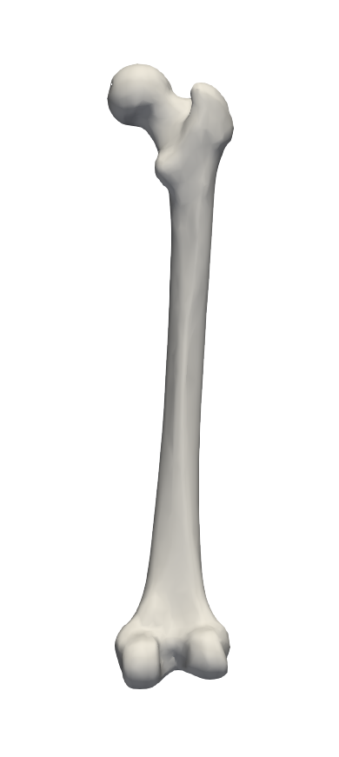

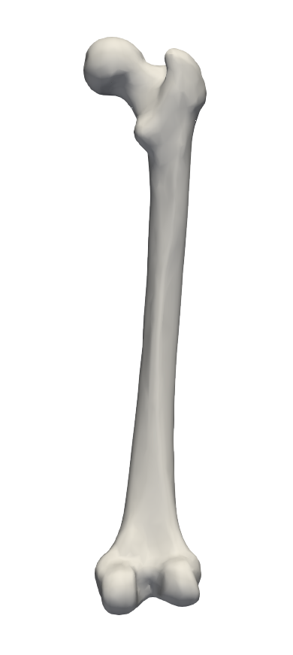

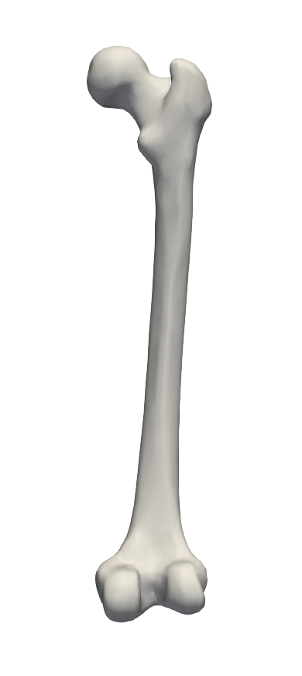
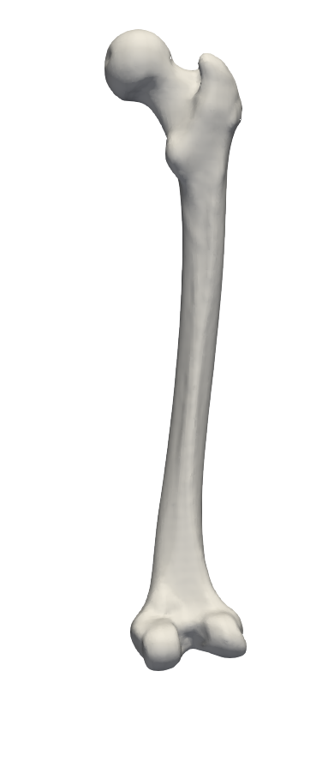
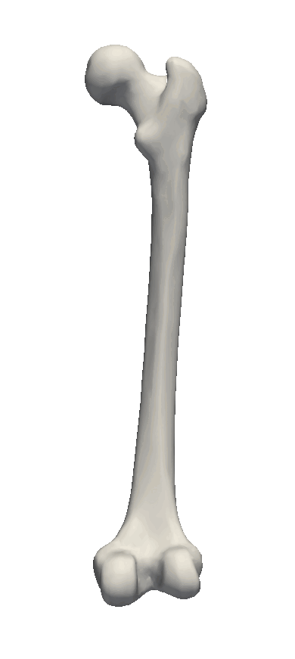
Gaussian Process Morphable Model
Gaussian Process Regression

Slide 11
Non-Rigid Registration

Slide 12
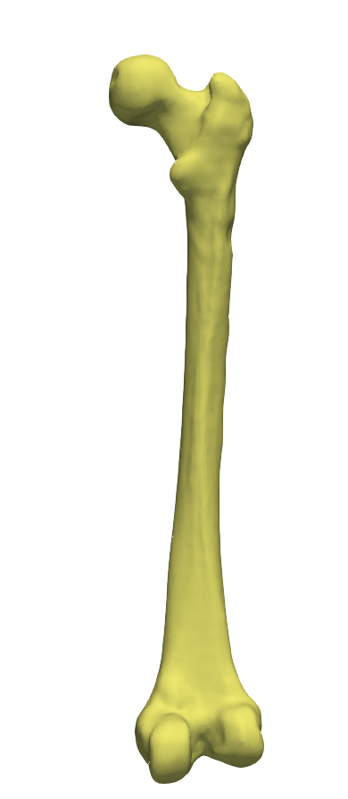
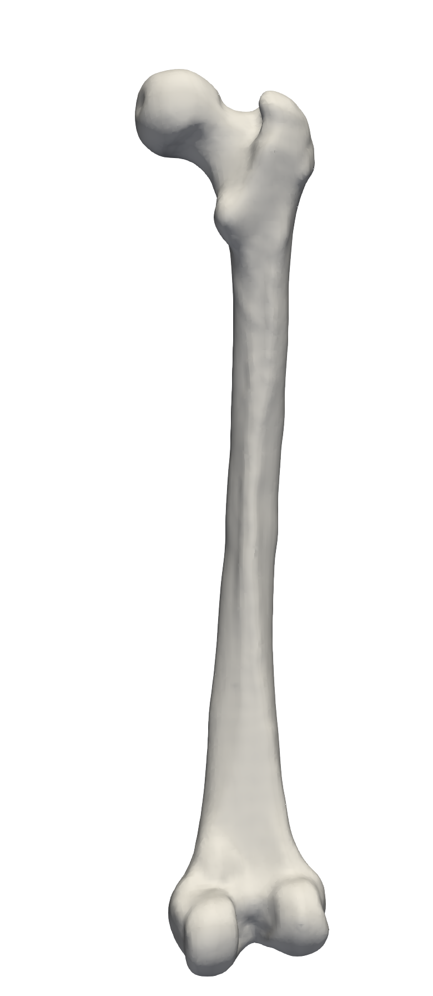
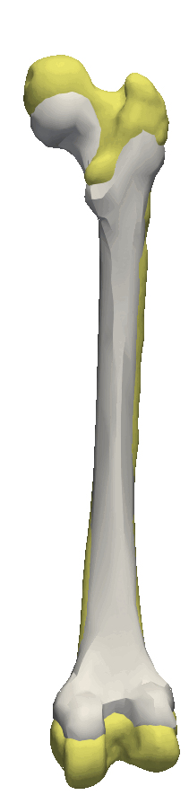
Non-Rigid Registration
Traditional:
Probabilistic Registration:

Slide 13
P-GiNGR

Slide 14
P-GiNGR
Probabilistic-GiNGR

Slide 15
P-GiNGR
Probabilistic-GiNGR
Generalized iterative Non-Rigid Point Cloud and Surface Registration Using Gaussian Process Regression

Slide 16
Metropolis Hastings
P-GiNGR
Propose
GPMM
Accept/Reject
Random-Walk
/
Correspondence Proposal
Burn-in phase
Posterior samples

Slide 17



GPMM
Correspondence
Accept/Reject
Uncertainty
/
P-GiNGR
GiNGR
Posterior mean
Posterior Sample
Posterior

Slide 18
P-GiNGR
/ GiNGR
CPD
ICP-T
ICP-A
GPMM
Kernel
Correspondence
Uncertainty
Point Set Registration: Coherent Point Drift
[Myronenko, Song PAMI 2010]
Optimal Step Nonrigid ICP Algorithms for Surface Registration
[Amberg et al, CVPR 2007]

Slide 19
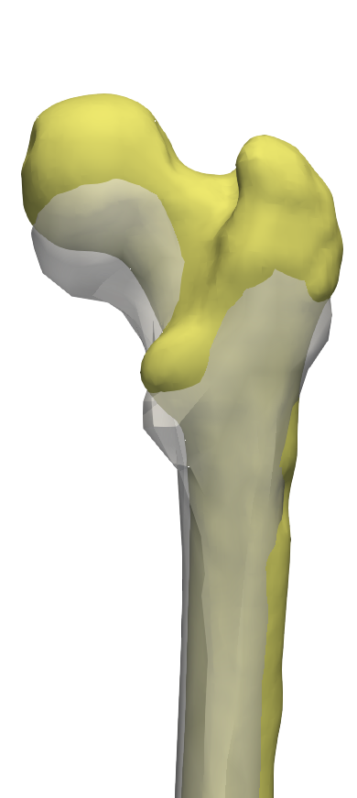
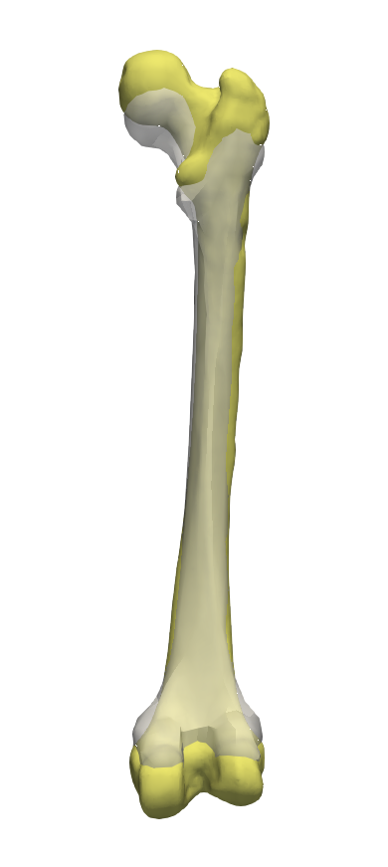
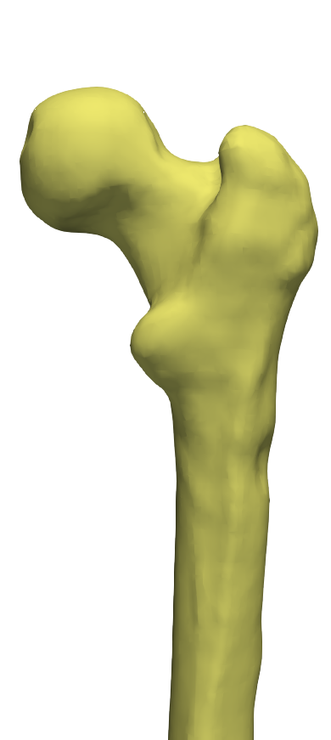
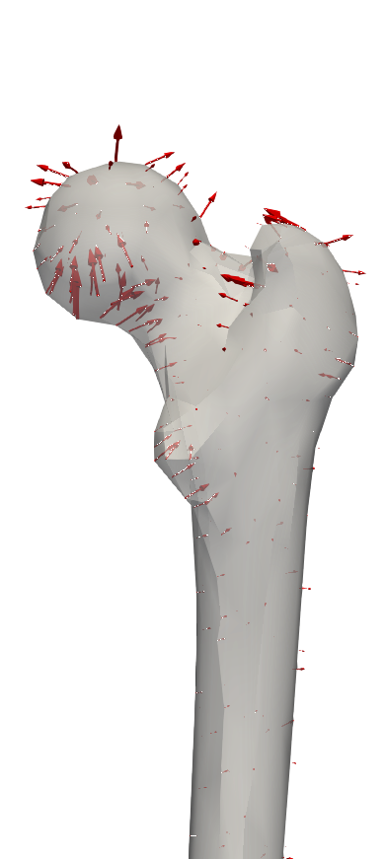

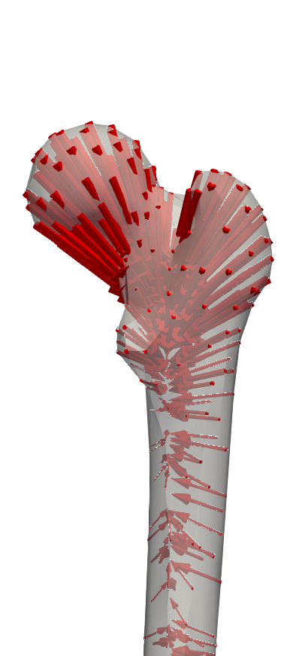
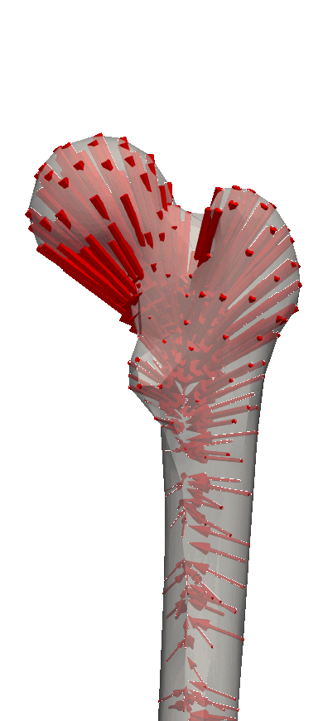
Estimation
Correspondence
ICP
CPD

Slide 20
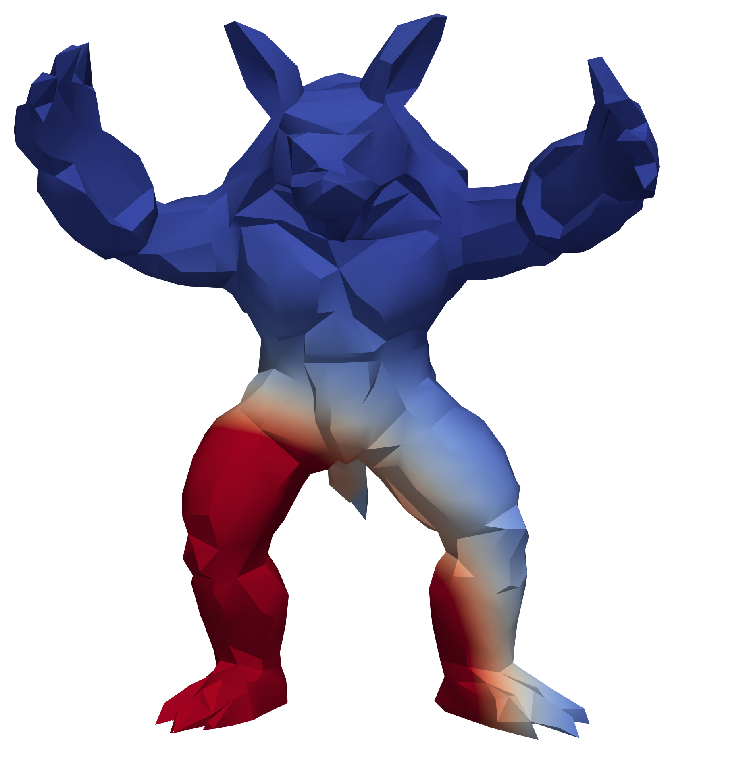
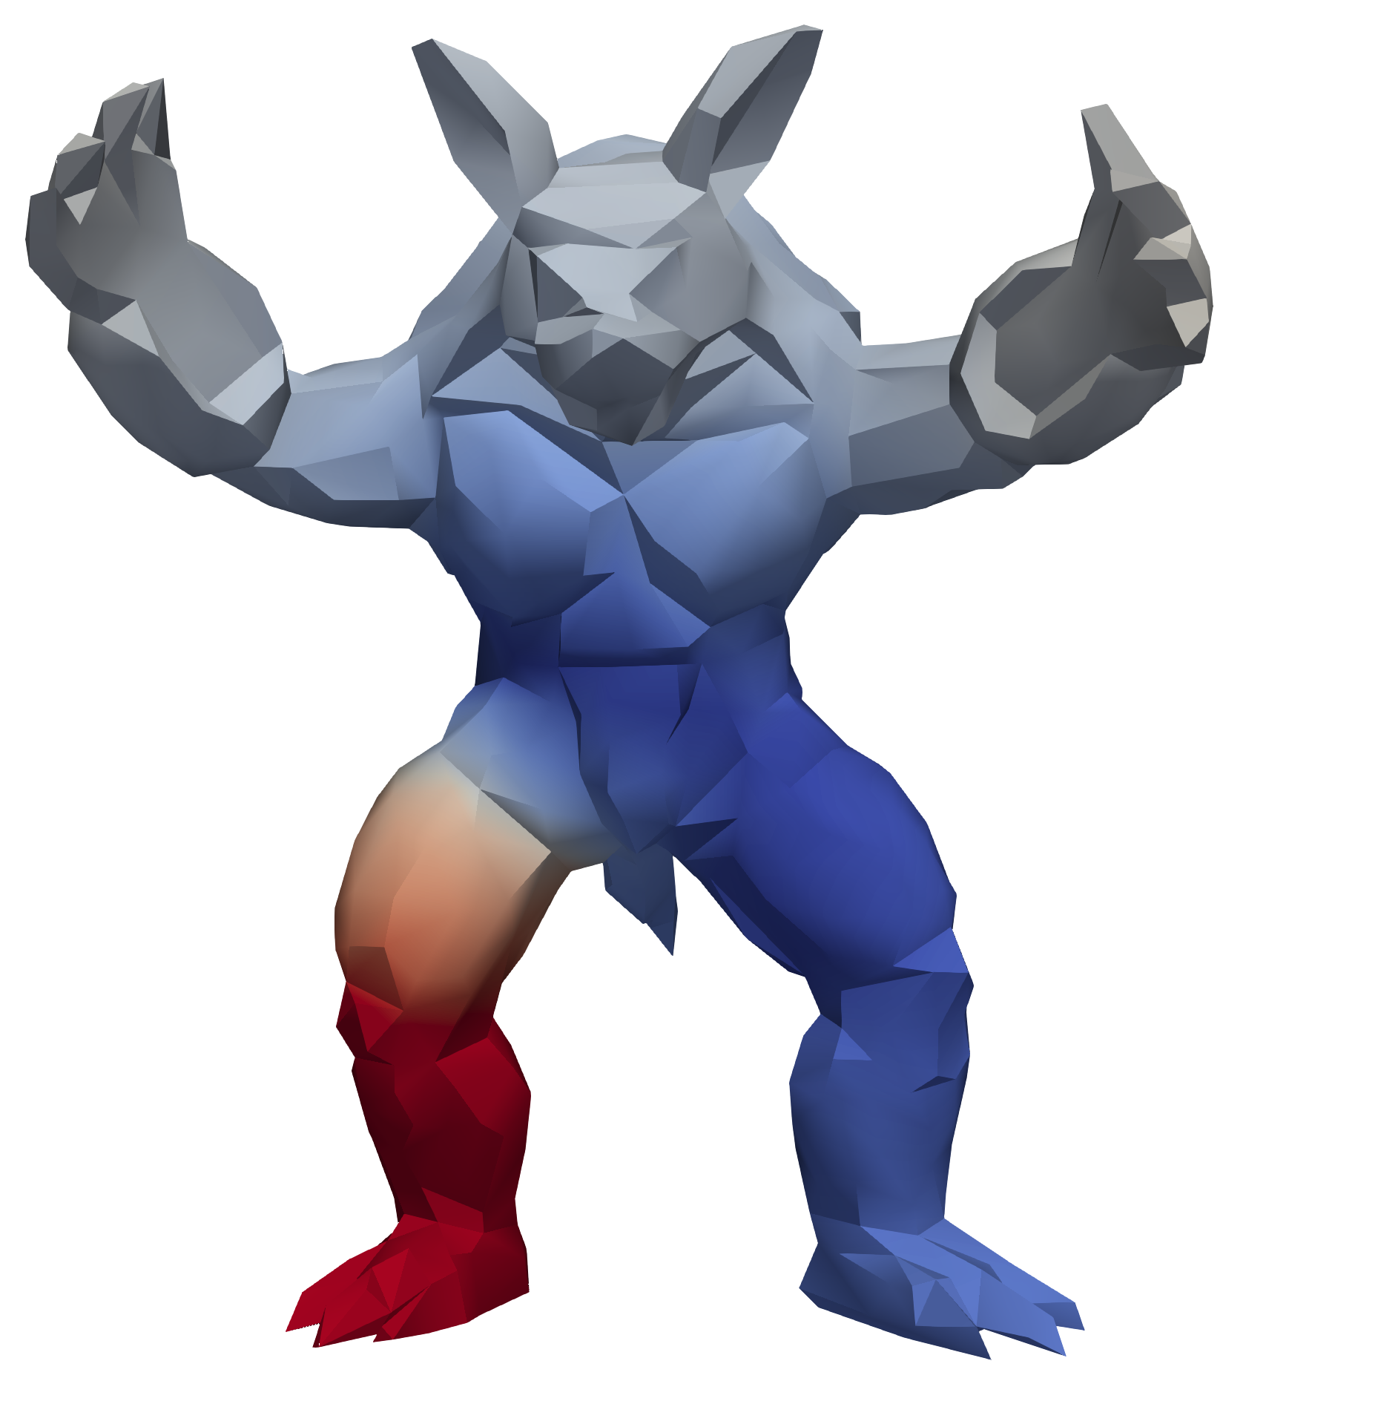
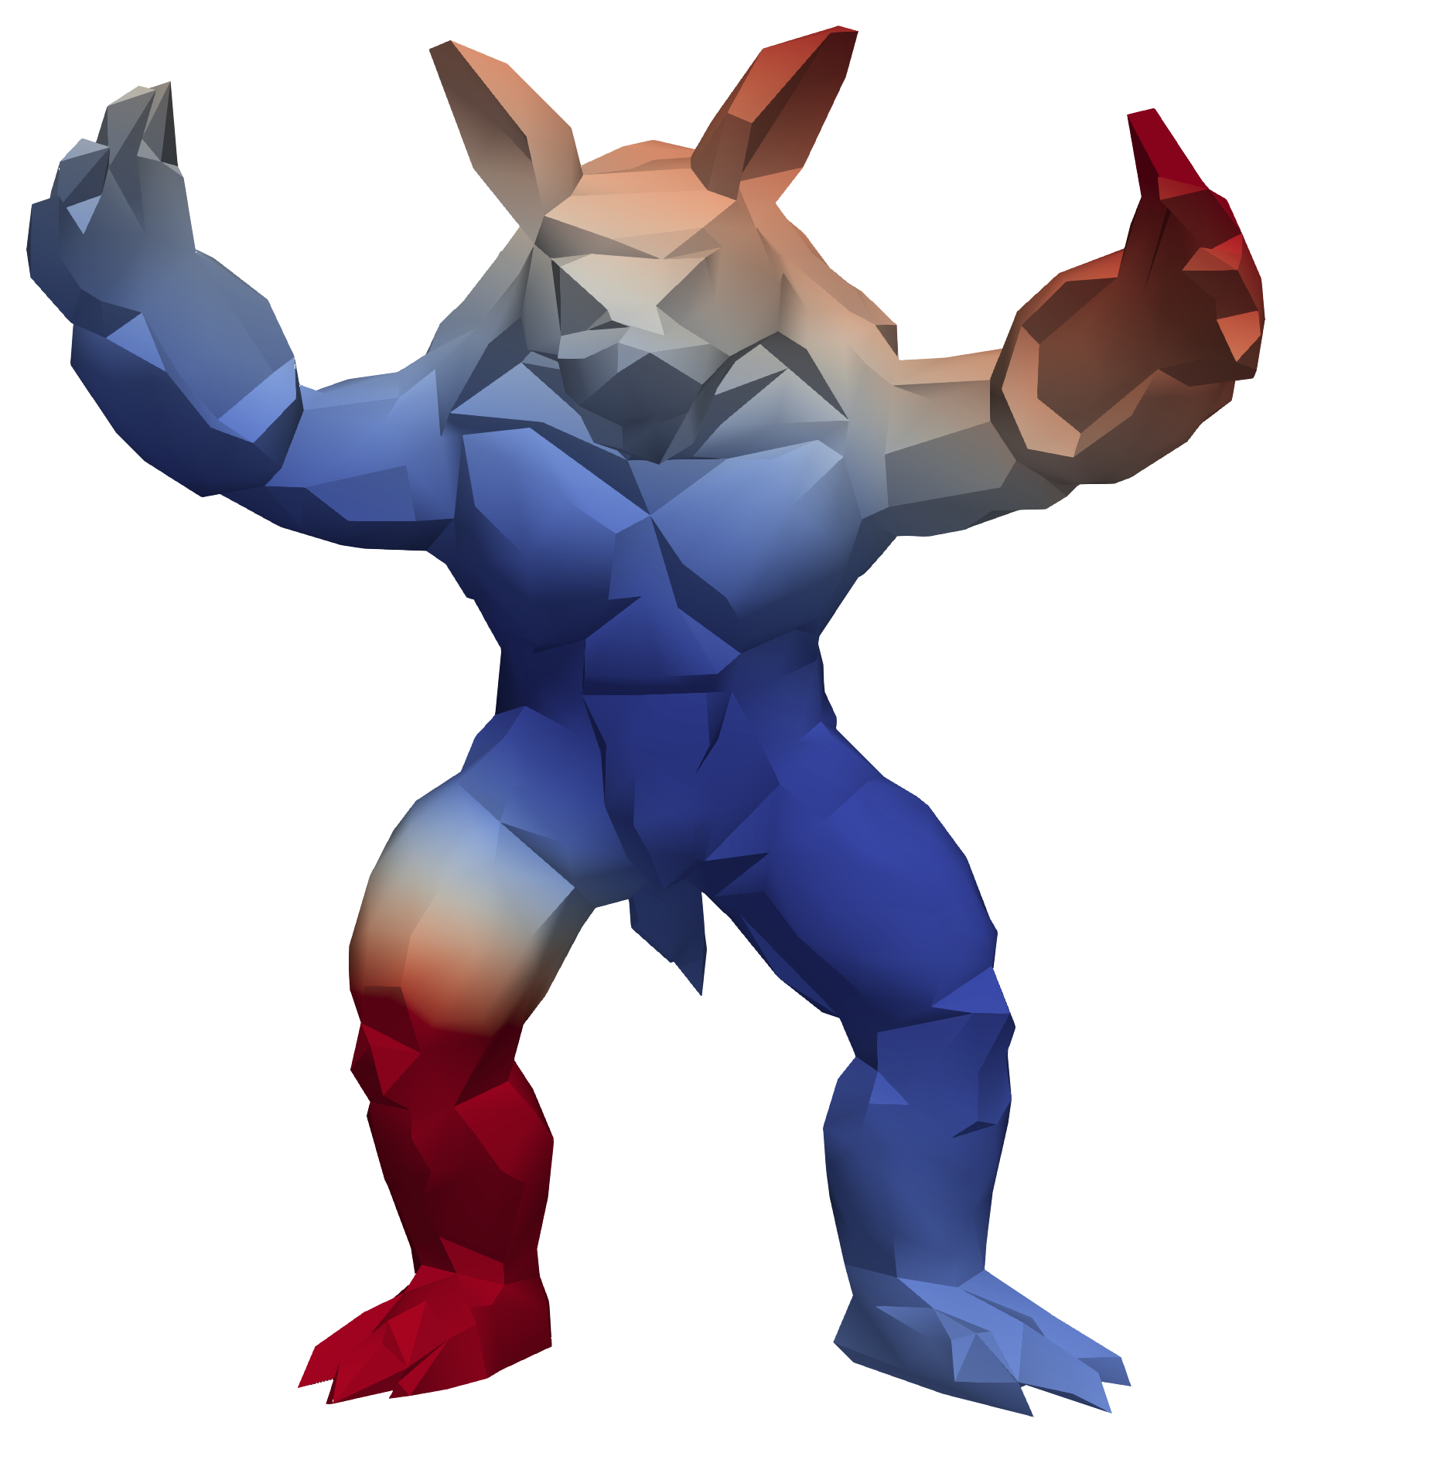
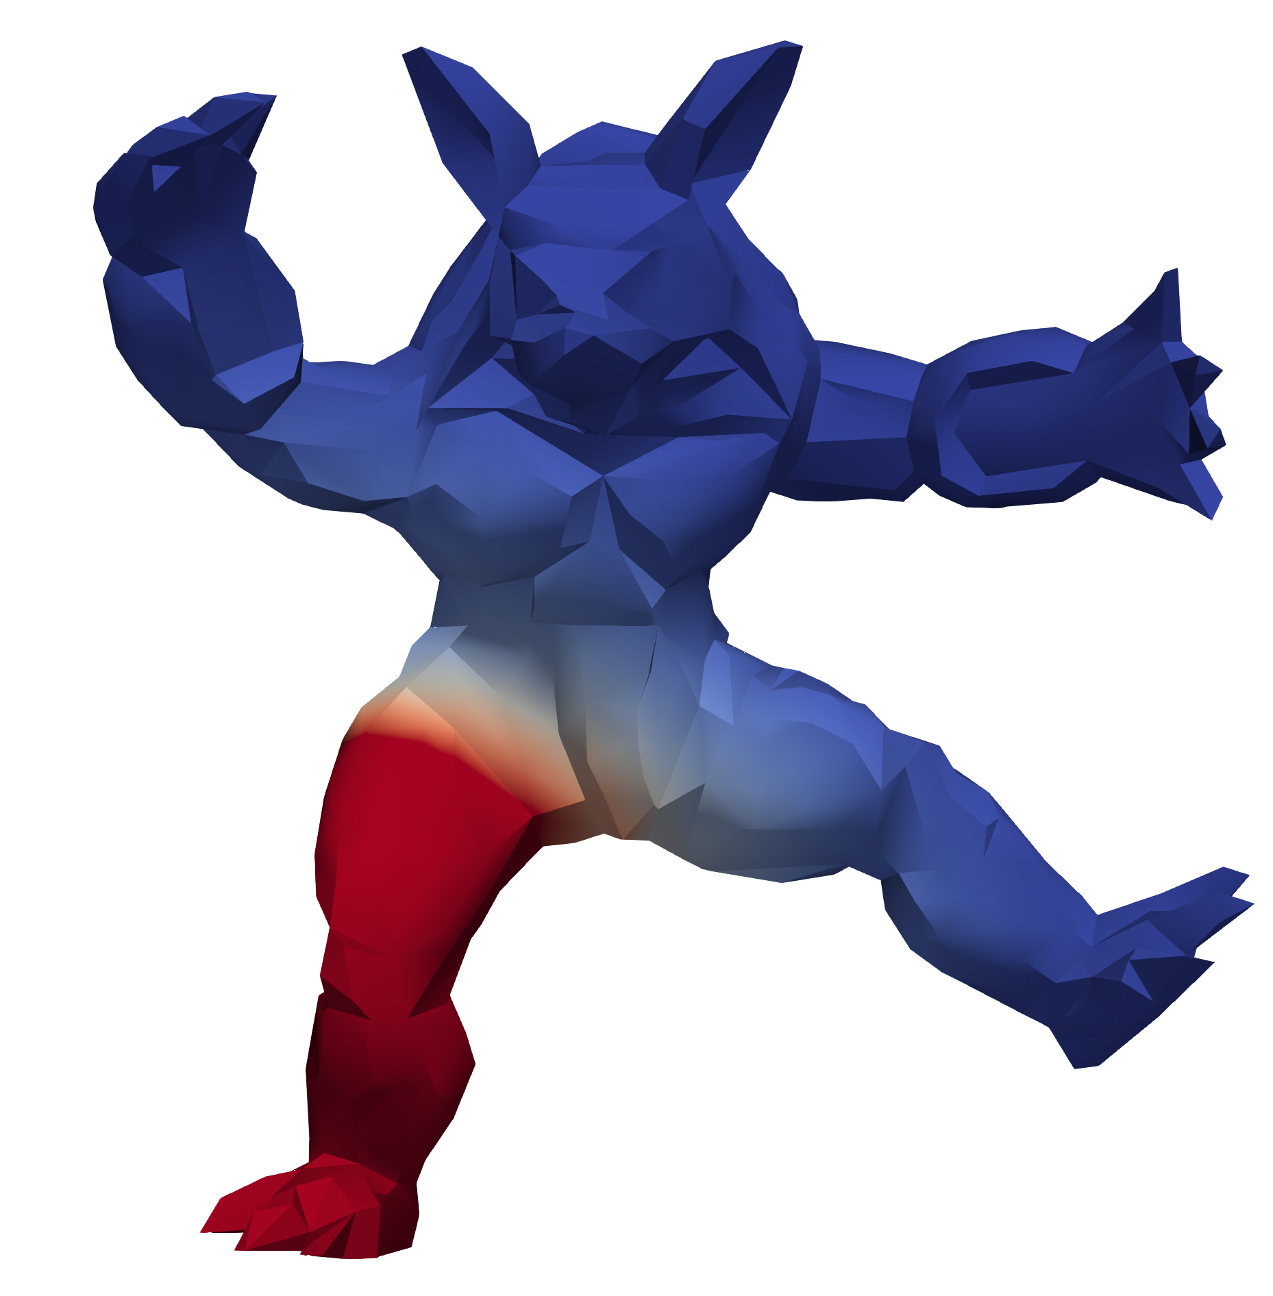
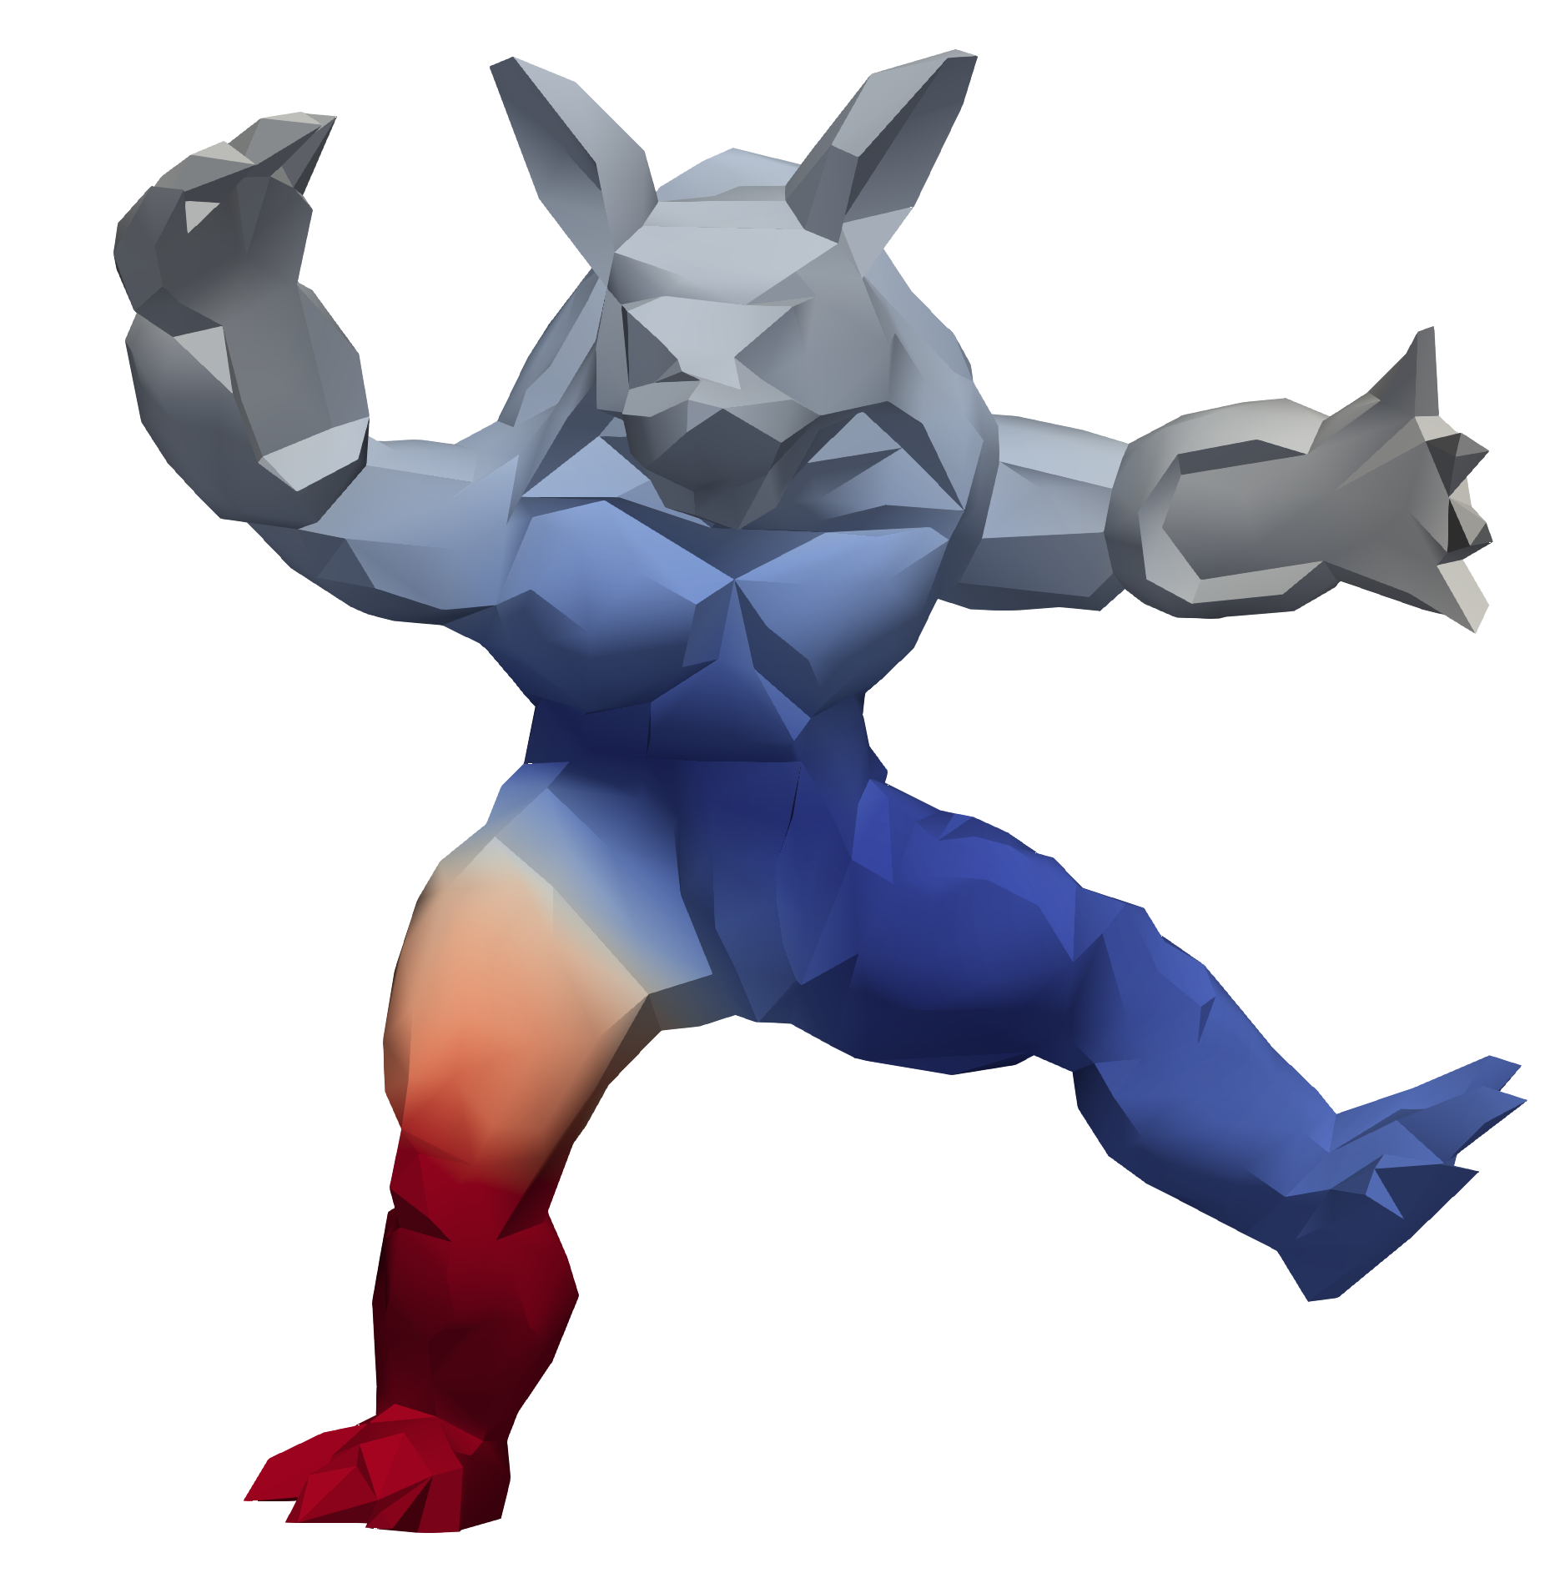
Gaussian
Kernel Correlation
ICP-A
CPD
ICP-T
inv Laplacian
dot product
x
inv Laplacian

Slide 21
P-GiNGR
/ GiNGR
CPD
ICP-T
ICP-A
GPMM
Kernel
Gaussian
inv Laplacian
dot x
inv Laplacian
Correspondence
Probabilistic
Closest Point
Closest Point
Uncertainty
Automatic
Independent
Manual
Global
Manual
Global
Point Set Registration: Coherent Point Drift
[Myronenko, Song PAMI 2010]
Optimal Step Nonrigid ICP Algorithms for Surface Registration
[Amberg et al, CVPR 2007]

Slide 22
GiNGR ICP
MAP Estimate Comparison
P-GiNGR ICP
GiNGR CPD
P-GiNGR CPD

Slide 23
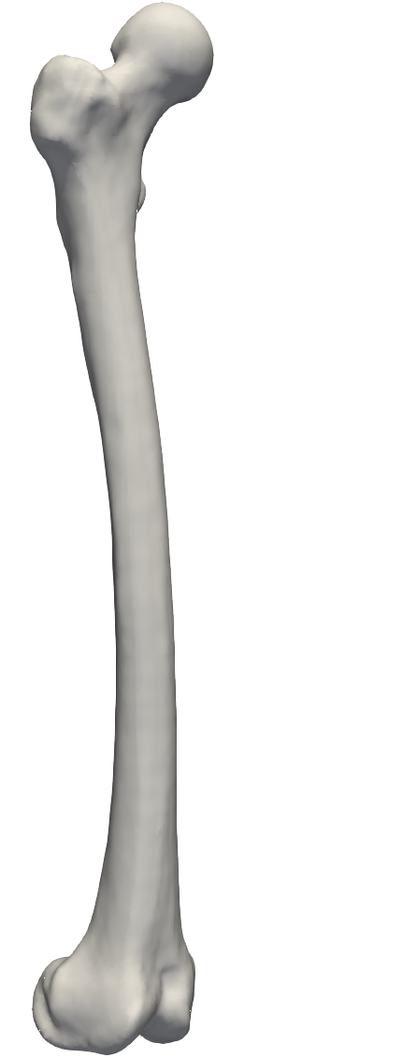



Target
Posterior
Normal

Slide 24
P-GiNGR

Slide 25
Applications
P-GiNGR

Slide 26















Applications
Build Statistical Models
Analyze Data

Slide 27



















Statistical Models from Partial Data
Red: Partial
Orange: Ground-Truth
Green: MAP
Blue: Mean
Black: Random Samples

Slide 28
Unseen data
Statistical Models from Partial Data
Training data

Slide 29
Conclusion

Slide 30
Conclusion
Accept/Reject
Correspondence
/
Uncertainty
P-GiNGR
GiNGR
Posterior mean
Posterior Sample
Posterior
?

